Slide 1
Virtual Memory
Chapter 8
Last Updated 10/24/2017 1:44 PM

Slide 2
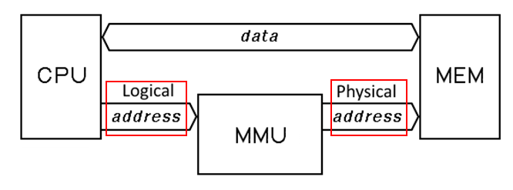
Logical to Physical Address Translation
Notes:
The process logical view of memory (addresses 0-N) is dynamically translated into physical addresses by the system’s memory management unit hardware.

Slide 3
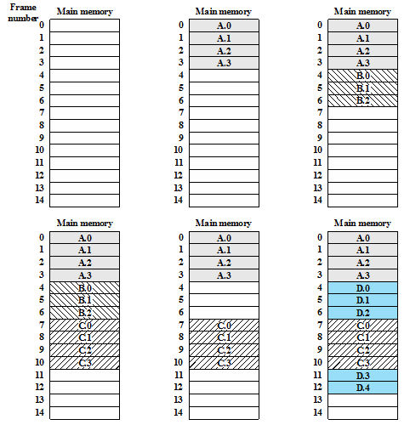
The Layout of Process Pages into Memory Frames
Notes:
Each memory frame is either empty or contains a page from one of four processes.

Slide 4
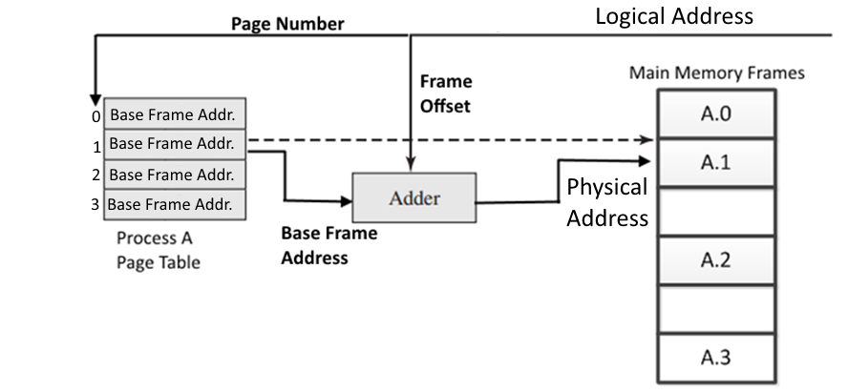
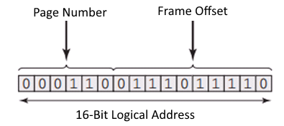
Paged Memory Mapping Maintaining the Logical to Physical Mapping for Process A

Slide 5
Review of Simple Paging
Because of the indirection between logical and physical addresses, a process’s pages can be located anywhere in memory and can be moved (relocated).
A process’s pages can swapped out and restored at a different frame in physical memory and the process’s page table updated to reflect the relocated page’s new frame address.
The frames occupied by a process’s pages do not need to be contiguous i.e. they can be spread throughout physical memory.

Slide 6
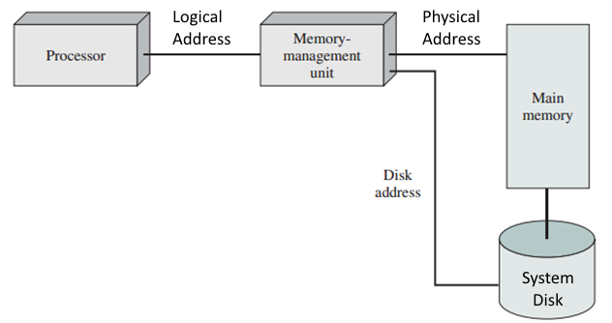
Virtual Memory Paging
The process image is maintained on the system drive.
Needed pages are ‘paged into’ main memory as they are referenced by the executing program.
Notes:
A new process’s image is created and maintained on the system’s swap drive. As the process executes, the pages it references are copied from the drive into memory.

Slide 7
Virtual Memory’s Key Feature …
Not all of a process’s pages need to be resident (in physical memory) as the process executes.
Only those pages (program, data, stack, etc.) that are being actively referenced by the process’s execution need to be resident.
Pages can be dynamically paged in and paged out of memory during the course of the process’s execution.
When the process references a page that is not resident, it is copied from swap disk into an available memory frame.
When a process is no longer referencing a page, it can be removed from memory freeing its frame for a different needed page.
Notes:
The principles of process blocking for I/O applies to page swapping. The process is blocked while an I/O operation moves the needed page from disk to memory.

Slide 8
Other Virtual Memory’s Features…
The system can maintain processes in memory whose image sizes sum to an amount larger than physical memory.
Because only parts of each process is maintained in memory.
The virtual amount of system memory is seemingly larger than the amount of physical memory.
The system can maintain more processes than would fit in physical memory if the entire process image had to be resident.
With more resident processes, we can expect better performance from the overall system.
With more processes active, there is an increased chance of having a process in the ready-to-execute state.

Slide 9
Memory Management Unit (MMU)
Virtual Memory is aided by hardware that dynamically maps a program’s logical address to a physical memory address.
The computer system’s Memory Management Unit (MMU) is hardware responsible for:
Mapping a program’s logical address onto physical frames.
Maintaining a per-process page table that describes where each page resides i.e. which memory frame (if any).
Ensuring that a process accesses only its frames.
A process cannot access the frames owned by other processes.

Slide 10
Virtual Memory Definitions Resident and Working Sets
The process pages that are located (resident) in memory frames are the process's Resident Set.
Initially, we will assume that the resident set size is fixed i.e. each process is allowed a fixed number of frames.
The process pages that are required to be in memory for the process to execute is the process's Working Set.
A process’s resident set should include its working set.
Pages in the Resident Set that are not in the Working Set are frames that could be used to maintain other processes.
So, a goal of the OS is to keep |RS| – |WS| to a minimum.
Notes:
|RS| – |WS| means the size of the resident set minus the size of the working set. Any pages in the resident set not in the working set is essentially wasted space.
In Linux the ‘top’ command can show us the process image size (VERT), the resident set size (RES), and the Shared Memory size (SHR).

Slide 11
Virtual Memory Definitions Continued Page Faults and Thrashing
A Page Fault occurs when a process access a non-resident page i.e. the newly access page must be loaded into a frame.
The number of times a process page faults over some period of time is its Page Fault Rate.
A process that can’t sustain its execution because its page fault rate is too high is said to be Thrashing.
Due to the fact that the process’s resident set is too small to hold its needed working set.
Again, assuming that the resident set size is limited to a maximize size.
Notes:
Later we will see that if a process starts to thrash, its resident set size can be increased to hold the new working set.

Slide 12
Principle of Locality
At any time, the pages that a process’s execution references will tend to cluster into a working set much smaller than the total process’s size.
Once the resident set encompass the current working set, a process will execute for a relatively long time without faulting.
The goal of virtual memory design is to maintain in the resident set those pages a process will reference in the near future.
That is, to minimize page faults.

Slide 13
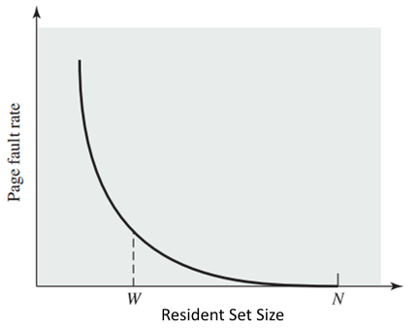
Resident vs Working Set vs Page Faults
The size of the resident set determines the page fault rate.
Too small a resident set causes the Page Fault Rate increases.
Too large a resident set results in the number of pages exceeding the working set and reducing the number of ready processes that can be supported.
Notes:
W represents a resident set size that is a trade off between PF rate and allocating too many pages to the process.
Remember that number of ready processes is tied to the system’s Processor Utilization.

Slide 14
Page Table
The system’s Memory Management hardware utilizes a lookup table (map) that translates a virtual (logical) address into a physical address.
Remember that the logical address describes the process’s address space.
Every process is assigned its own page table…
And the process page table is maintained in main memory.
One of the activities of a process context switch (ready → running) is to initialize the MMU hardware with the base address of process’s page table in memory.

Slide 15
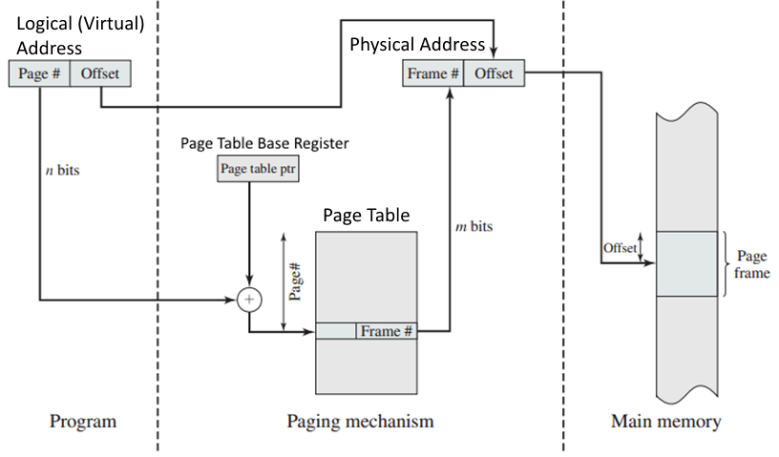
Single Level Page Table
Notes:
A process page table is maintained in main memory.

Slide 16

Page Table Entries
A Page Table containing multiple entries.
Each entry references a memory frame allocated to the process.
Each entry maintains a “present in memory” bit.
Each entry maintains a “modified” or dirty bit.
The Present Bit indicates whether the page is loaded into a frame.
The Modified Bit indicates whether it is necessary to write the page contents back to disk when it is swapped out.
Other control bits may control Read-Write vs Read-Only, and information used to by a Page Replacement Policy.

Slide 17
Page Table Size
The potential number of pages that can be allocated to a process is very large.
2³² address range with a page size of 2¹²(4096) = 2²⁰ PT entries.
A Page Table Entry of 4 bytes requires a 2²² (4 mB) page table.
2⁶⁴ address range with a page size of 2¹²(4096) = 2⁵² PT entries!
A Page Table Entry of 4 bytes require a 1.8e16 byte page table.
An entire 64-bit process’s page table cannot be held in physical memory.

Slide 18
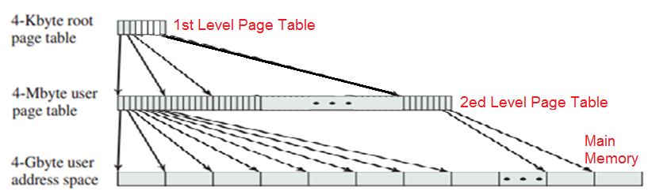
Two Level Page Table
A two levels page table uses a tree-like structure of page table entries to maintain the process’s page table.
The 1st page table maintains the addresses of needed 2^{ed} level entries or null.
Second level page tables entries are allocated as needed by the size of the process image.

Slide 19
Two-Level 32bit Page Table Addressing

Slide 20
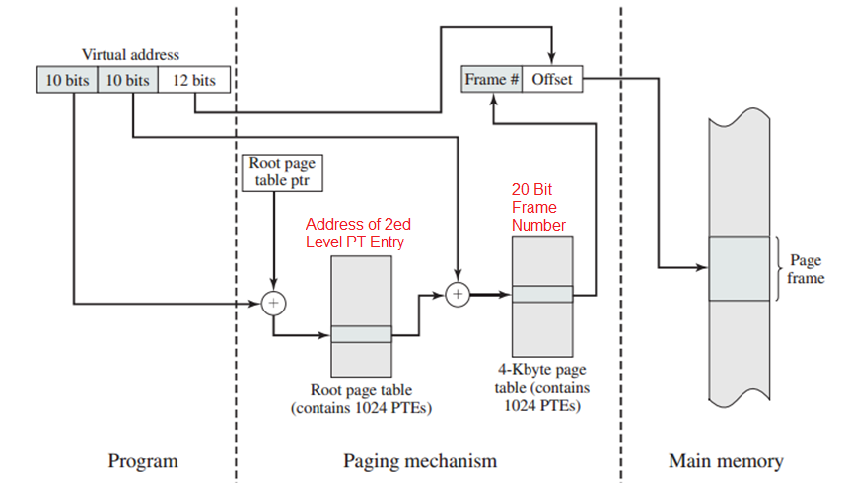
Two-Level 32bit Page Table Addressing
Notes:
Key point: Only a few of the second level page table entries will be used (loaded into memory).
This example is for a 32 bit physical address range.

Slide 21
Two Level Page Table
A flat, single level page table requires that all PT entries be allocated in the memory even if most PT entries are empty.
Most processes will utilize a few hundred PT Entries.
A two level page table allocates only those second level entries that are needed by the process.
Greatly reducing the total amount of memory needed to maintain a process’s page table.
WIKI Entry for Page Tables

Slide 22
Translation Lookaside Buffer AKA Page Table Cache
Recall that a process’s page table is maintained in kernel memory i.e. in physical memory.
With a one-level page table, every logical memory reference made by the processor requires 2 physical memory references
1 to access the page table entry and 1 for the memory reference.
A two-level page table requires 3 physical memory accesses.
2 to access the page table and 1 for the memory reference.
One approach to reducing physical memory access is a cache mechanism called the Translation Lookaside Buffer.
Also known as the Page Table Cache.
This is a cache of the N most recent page table accesses.

Slide 23
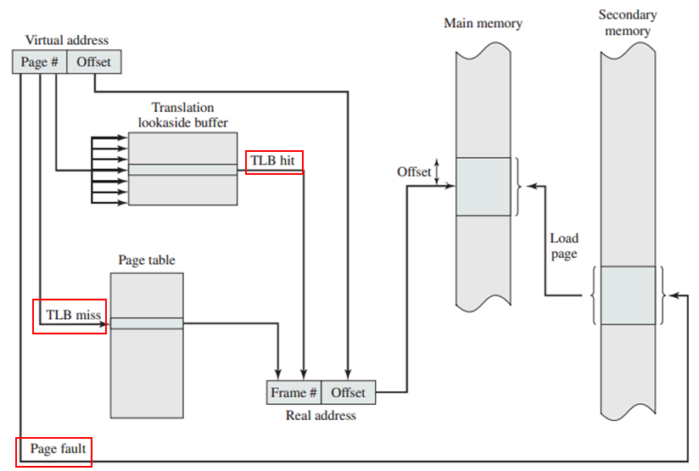
Translation Lookaside Buffer w/ Single-Level PT
Notes:
The Frame# can be obtained from the TLB (if present) or from the Page Table which resides in memory.
The page table entry includes a ‘present in memory’ to indicate whether the page table frame is in memory.

Slide 24
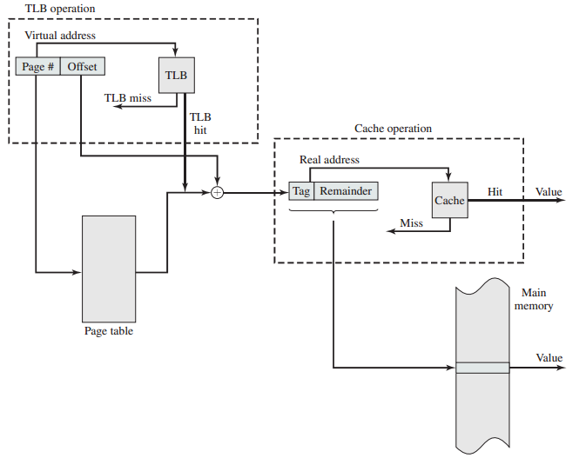
Page Table and Main Memory Cache Recall that main memory provides its own L1 – L2 cache.
Notes:
We have two cache lookups 1) the TBL cache for the page table entry 2) the system’s memory cache.

Slide 25
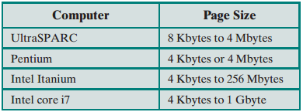
Factors That Determine the Page Size
Smaller page sizes reduces Internal Fragmentation.
Smaller the page, the more efficient the memory utilization.
Smaller page sizes increases the size of the Page Table, TLB, and other support hardware (Bad).
Larger page sizes decrease complexity of MMU designs (Good).
The efficiency of swapping I/O operations. Larger page size produces more efficient disk transfers (Good).
The size of the page is equal to the size of the disk block.
Notes:
As the table shows, most modern operating systems use a page size of 4K.

Slide 26
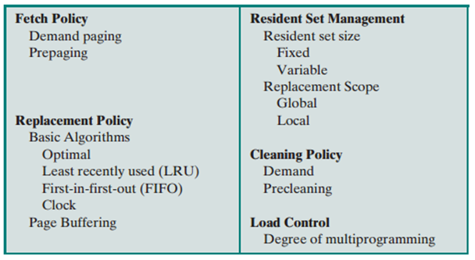
Operating System Support for VM
The operating system implements policies, or algorithms, that controls how pages are allocated and managed on behalf of the resident processes.

Slide 27
Fetch Policy
Fetch Policy determines when a page is made resident i.e. moved (swapped) from disk into memory.
Demand Paging: Copies pages from swap into memory as they are accessed by the process i.e. on demand.
Note that when a process first starts, there is a flurry of page faults as pages from program and data segments are copied into memory.
But as a working set is established, the fault rate will drop and the process will execute for extended periods without faults.

Slide 28
Prepaging Fetch Policy
Prepaging: Swaps in the referenced (demanded) page and pages in the image adjacent to the demanded page.
Prepaging makes efficient use of the slowest device in the memory hierarchy i.e. retrieval of blocks from disk.
If the process image is stored contiguously on disk (on adjacent disk blocks), the cost of bringing in an adjacent disk block is insignificant compared to bringing in the first block.
Although there is the possibility that additional swapped-in pages will never be accessed.
Notes:
Note: This adjacent block concept only applies to Hard Disk Drives (Not Solid State Drives).

Slide 29
Replacement Policy
The selection of which resident page to replace when no free frames exist in memory and a new page is required.
The goal is to pick the frame whose resident page will not be accessed by its process in the near future (if at all).
If a page is removed and is immediately accessed when its process runs, we have wasted at least one, possibly two I/O operations.
Note: An unmodified page does not need to be copied back to disk when it is replaced.
Conversely, replacing a modified page requires two I/O operations.

Slide 30
Page Replacement Policies
Five Replacement Policies will be discussed that differ …
In the accuracy each has in selecting the best page for replacement
i.e. the page which will provide the best return on the time needed to replace it.
The hardware and processor overhead needed to implement a policy.
An algorithm that provides fractionally better memory utilization but requires more resources may not be the best choice.

Slide 31
Optimal Replacement
Optimal: A hypothetical solution that always selects the pages that will not be access for the longest amount of time.
If optimal could be implemented, it would minimize the process’s fault rate and provide the most efficient utilization of the assigned physical memory.
The optimal solution can not be implemented but it provides a benchmark against which other policies are evaluated.
Notes:
The optimal solution can not be implemented in practice (it is a simulated result) but the performance of an optimal replacement policy provides a benchmark against which other algorithms are evaluated.

Slide 32
Least Recently Used (LRU) Replacement
Select for replacement the page that has not been referenced for the longest time.
Locality of Reference suggests that the Least Recently Used page is unlikely to referenced in the near future.
Simulation shows that LRU is almost as efficient as Optimal.
LRU is too expensive to implement for virtual memory.
Needs to attach a last-accessed timestamp to every PT entry and search for the oldest page during each replacement operation.
Maintain page accesses in a stack and pick from the bottom.
Notes:
Cover stack for homework question.

Slide 33
First-In First-Out (FIFO) Replacement
Replace the page that has been resident the longest.
Easy to implement by treating the frame table as a circular buffer.
When all frames are occupied, remove the first, second, etc. pages that were made resident.
FIFO is an ineffective page replace policy.
Removes pages regardless of whether they are in use or not.
Can remove pages that are constantly referenced causing these pages to fault soon after having been removed.

Slide 34
Clock Replacement Policy
Clock Replacement is an efficient method of approximately identifying the LRU page.
Each frame table entry maintains a use-bit that indicates when a page is accessed.
The use-bit is set 1 when the frame is first loaded with a new page.
The use-bit is set 1 each time the frame is accessed.
The algorithm is to:
Starting with the last frame selected for replacement.
Move though the frame table in a circular fashion (top to bottom).
Select for replacement the first frame whose use-bit is 0.
As each entry is visited, if the use-bit is 1, set it to 0.

Slide 35
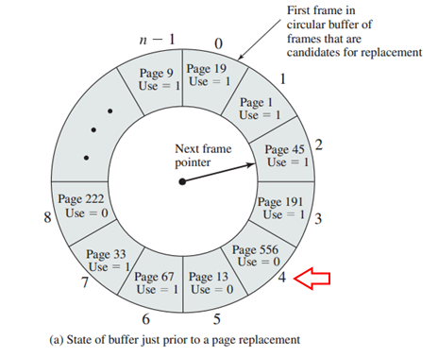
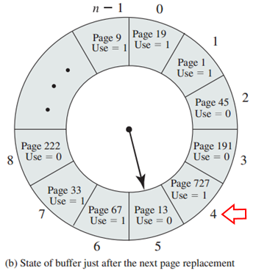
Clock Replacement Frame Table

Slide 36
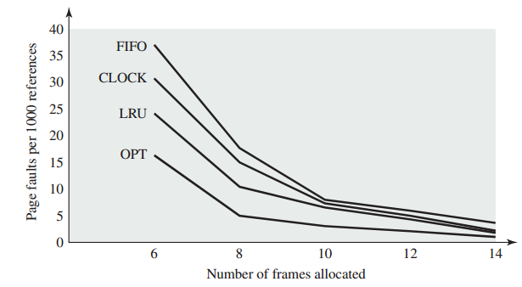
Clock Replacement Policy
During the first pass though the frame table, the first frame / page that has not been accessed (use-bit = 0) will be replaced.
This is an approximation of LRU.
If all use-bits are 1 during the first pass, the second pass will select first frame set to 0 in the first pass for replacement.
A comparison study presented in the book indicates that Clock replacement produces fewer page faults than FIFO.

Slide 37
Clock Replacement with Modified Bit
A variation that uses an additional modified-bit to avoid selecting pages that need to be written back to disk if replaced.
The strategy is to initially avoid replacing pages that have been modified and will require two I/O operations to replace.
Each frame can be marked with 2 bits (u = use-bit, m = modified-bit).
Not recently used, not modified (u=0, m=0)
Not recently used, modified (u=0, m=1)
Recently used, not modified (u=1, m=0)
Recently used, modified (u=1, m=1)

Slide 38
Clock Replacement with Modified Bit
As many as four passes may be made though the frame table.
Pass 1: The first page with (u=0, m=0) is selected. Makes no changes to the use bit.
Fails when no unused, unmodified pages are found.
Pass 2: The first page with (u=0, m=1) is selected. The use-bit is set from 1 to 0 during Pass 2.
Fails when no unused, modified pages found.
Pass 3: The first page with (u=0, m=0) is selected. This pass fails if all pages have been modified.
Fails when all the used pages are modified.
Pass 4: The first page with (u=0, m=1) is selected.
All the original pages were used and modified.
Notes:
The key is setting u=0 during second pass, and selecting the first m=0 on the third pass.
See page 268

Slide 39
Random Replacement Policy
Randomly select a resident page for replacement.
Can be implemented very efficiently.
Requires a fast pseudo random number generator.
No sweeping of the frame table looking for acceptable page.
The text reports that random replacement policy performs better than FIFO in practice.

Slide 40
Resident Set Size Management
Determine how many frames of memory to allocate to each process i.e. the size of the process’s resident set.
The goal is to select a resident set size just large enough to keep the process’s page fault rate at an acceptable minimum.
Smaller resident sets, allow more processes to fit into memory and increase the chance of the OS finding a ‘ready’ process.

Slide 41
Resident Set Size
Too small a resident set and the process’s page fault rate will increase as the working set can not be maintained.
Past a certain point, increasing the resident set size will have little effect on decreasing fault rates because of locality of reference.

Slide 42
Frame Assignment Policies
Variable Allocation: The number of frames allocated to the process varies over its lifetime.
The number of frames can be increased / decreased based on runtime criteria such as the process’s page fault rate.
However, monitoring the page fault rate and adjusting the number of frames requires additional OS overhead on the system.

Slide 43
Process’s Working Set
A process’s working set is defined as the pages that are currently needed by the process to execute.
The process is ‘runnable’ only if its resident set includes its working set.
Working set is collected over a time period.
Record the pages visited during a time range [t, t+i].
Too small a time range may lead to thrashing.
Too large a range may lead to including pages no longer in the process’s current region of locality.
Over time, a process’s working set will vary in size as its execution moves from one region of locality to another.
See next slide.

Slide 44
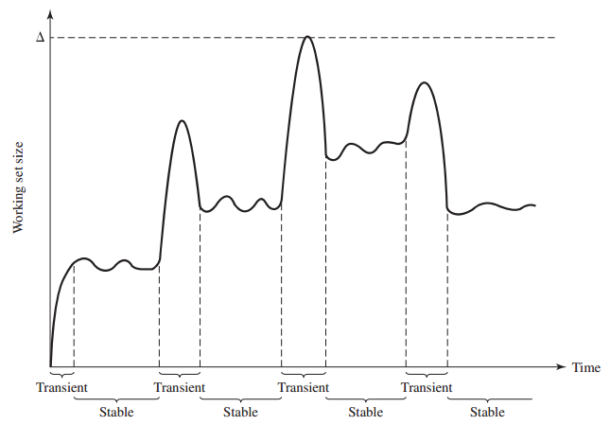
This behavior indicates that a process’s resident set should grow during periods of transition and shrink during periods of stability freeing memory for other processes.
Notes:
According to the book (pg 374), delta represents the surge in the WS size during the transient periods when pages from the old and new resident set are being accessed (and the pages that bridge the two regions).
The difference between the old WS size and the new size.

Slide 45
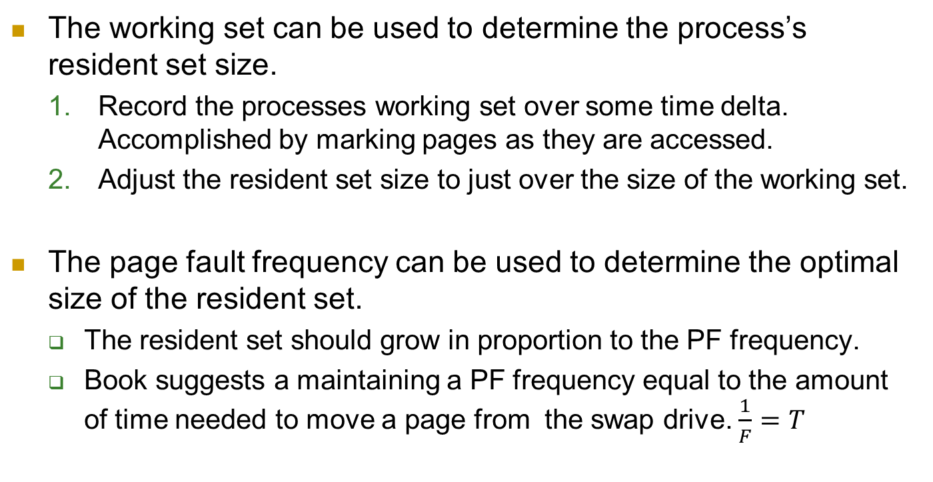
Two Methods of Determining the Resident Set Size
The working set can be used to determine the process’s resident set size.
Record the processes working set over some time delta. Accomplished by marking pages as they are accessed.
Adjust the resident set size to just over the size of the working set.
The page fault frequency can be used to determine the optimal size of the resident set.
The resident set should grow in proportion to the PF frequency.
Book suggests a maintaining a PF frequency equal to the amount of time needed to move a page from the swap drive. $\frac{1}{F}=T$
Notes:
These two methods are complementary. Gathering the working set determines which pages to remove from the resident set and the PF frequency can be used to determine when to clean the resident set.

Slide 46
Cleaning Policy
The cleaning policy is concerned with determining when a modified page should be written to disk.
With Demand Paging, a modified page will be written when it has been selected for replacement.
A Precleaning Policy will write dirty pages before they are selected for replacement to increase efficiency by batching page writes into a single I/O operation.
Taking advantage of the location of the disk drive heads to write dirty pages when the disk operation is most efficient.

Slide 47
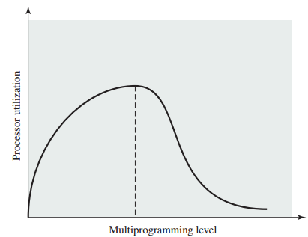
Load Control
Load Control determines which processes are maintained in memory and which are suspended.
Too few processes and the processor will be idle when all processes are blocked.
Too many processes and combined working sets will be too large to load into memory i.e. thrashing.
The chapter describes two methods of approximating processor utilization that can be used to determine which processes to suspend process.
Given as assessment questions.

